Slide 1





MACHINE LEARNING PROJECT
THEORY & APPLICATION
Presented by: DHARAMVIR SINGH
Id :HE23546

Slide 2

INTRODUCTION
Machine Learning (ML) is revolutionizing industries such as finance, healthcare, and digital services.
Organizations are using data-driven models for prediction and optimization.
The aim of this coursework is to demonstrate understanding of ML theory and practical applications.
Two Major Tasks:
Theoretical foundations, algorithms, loss functions, overfitting, and ethics.
Building and optimizing a regression model for predicting house prices.

Slide 3
SCENARIO ANALYSIS
Stock Price Prediction → Supervised Learning (Regression). Uses labeled historical data to forecast stock prices.
Patient Segmentation → Unsupervised Learning (Clustering). Groups patients into categories without labels for personalized treatment.
Content Flagging → Supervised Learning (Classification). Identifies harmful or inappropriate content using labeled datasets.

Slide 4

K-MEANS VS KNN
K-Means Clustering:
Type: Unsupervised Groups unlabeled data into clusters. Example: Customer segmentation. Strength: Simple, scalable. Weakness: Sensitive to outliers.
K-Nearest Neighbors (KNN):
Type: Supervised Classifies based on nearest labeled data points. Example: Spam email detection. Strength: Easy to implement. Weakness: Slow on large datasets.

Slide 5
LOSS FUNCTIONS
Loss function quantifies the discrepancy between a model's predicted and actual outcomes.
Linear Regression
Metric: Mean Squared Error (MSE) Formula:
MSE=n1​∑i=1n​(yi​−y^​i​)2
Example: For a given dataset, the MSE is 0.11.
Significance:
Exaggerates the penalty for significant prediction errors.
Differentiable, which is essential for model optimization through gradient descent.
Alternatives include Mean Absolute Error (MAE) and Huber Loss.

Slide 6
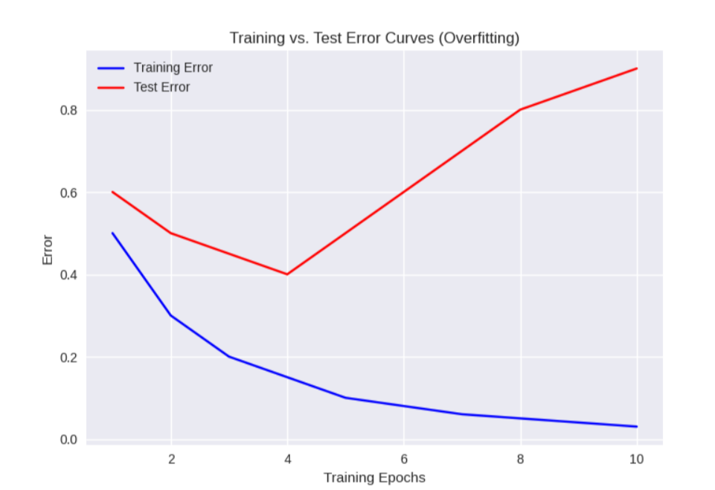
OVERFITTING
Definition: Model performs well on training data but poorly on unseen data.
Causes: Complex models, too few samples, noisy datasets.
Consequences: Poor generalization, unreliable predictions.
Solutions: Use Regularization (L1, L2).
Apply Cross-validation.
Add more training data.
Simplify model structure.

Slide 7
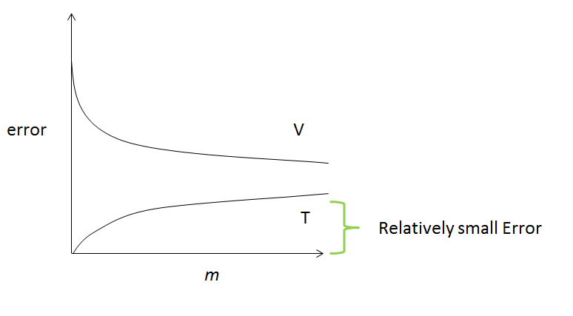
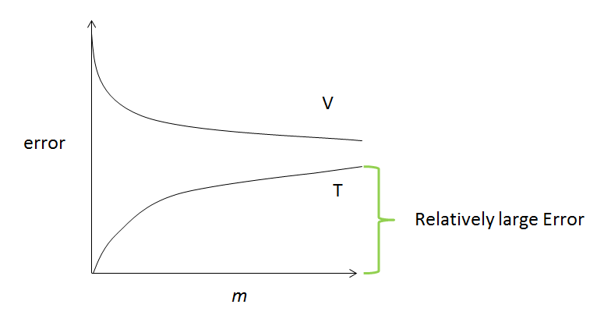
ERROR CURVES
Curve I –
Overfitting: Low training error, high validation error.
Actions: Add data, apply regularization, simplify model.
Curve II –
Underfitting: Both training and validation errors are high.
Actions: Increase model complexity, improve training quality

Slide 8
RISKS IN M
Bias: Issue: A facial recognition system incorrectly identifies individuals with darker skin tones.
Errors: Issue: A medical diagnosis from an AI model is incorrect, leading to patient harm.
Low Generalization: Issue: A model trained on city data performs poorly when used in rural areas.
Accountability: Issue: Determining who is liable when an autonomous vehicle is involved in a collision.
Summary: Ethical machine learning demands fairness, transparency, and governance.

Slide 9
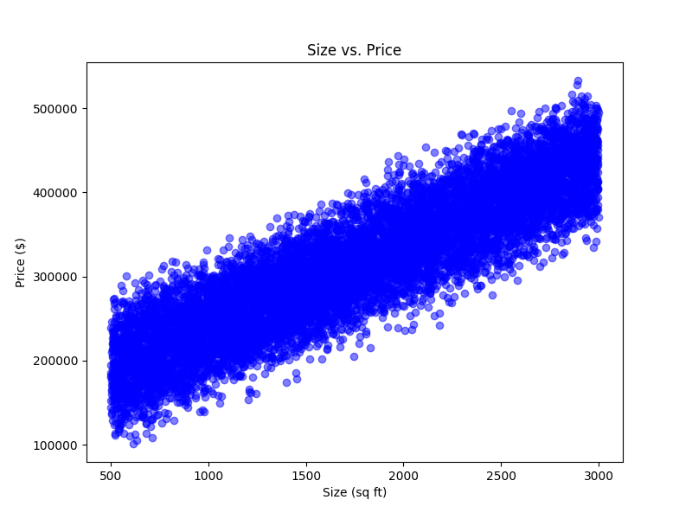
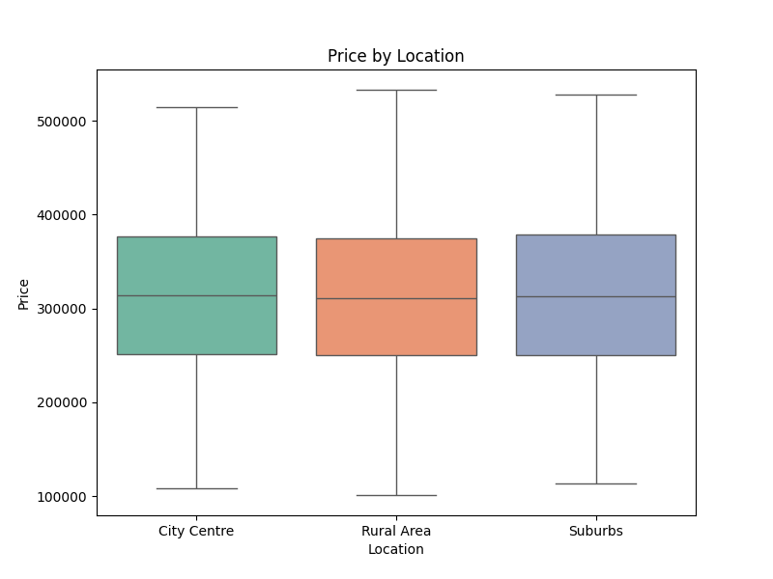
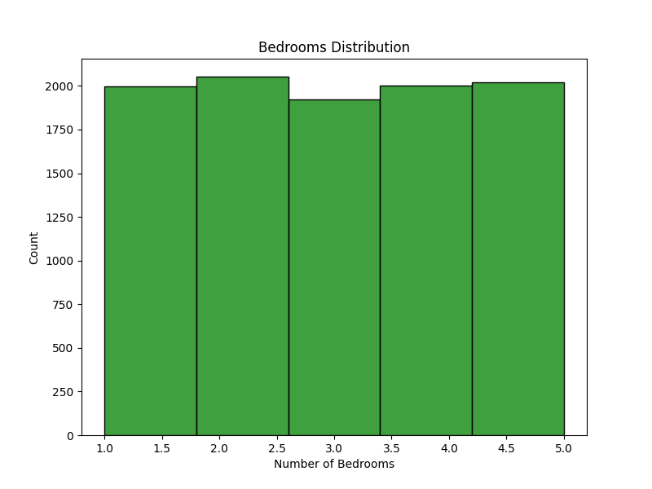
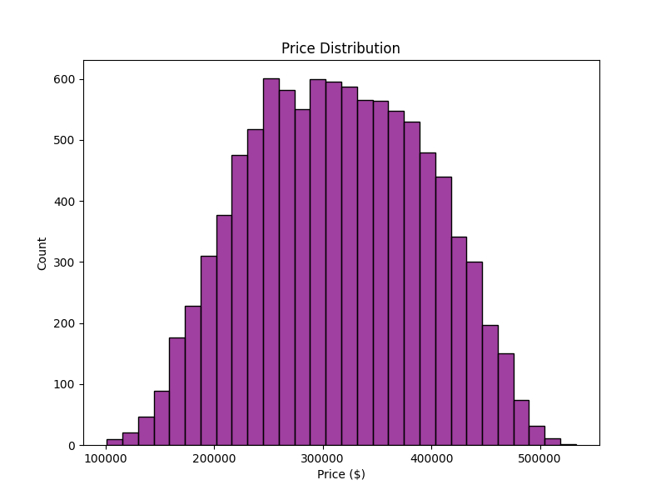
DATA EXPLORATION
Model Data:
Source Data: 10,000 instances, each with features like Area, number of Bedrooms, number of Bathrooms, Geographic Position, and Value.
Preparation: Categorical data was converted using one-hot encoding, while numerical data was normalized.
Findings:
A strong connection was found between Area and Value.
The Geographic Position influenced the range of Values.
The count of Bedrooms was spread out consistently.
The Value followed a pattern close to a normal distribution.

Slide 10
MODEL SELECTION
Trained Models:
Linear Regression: A simple model that is easy to understand and provided strong results.
Decision Tree: Capable of identifying complex patterns but can sometimes overfit the training data.
Random Forest: An ensemble method that effectively balances high accuracy with good generalization.
Evaluation and Outcomes: The models were assessed using several metrics, including Mean Squared Error (MSE), Root Mean Squared Error (RMSE), and R-squared (R2). The Linear Regression model was the top performer, achieving an R2 score of 0.94.

Slide 11
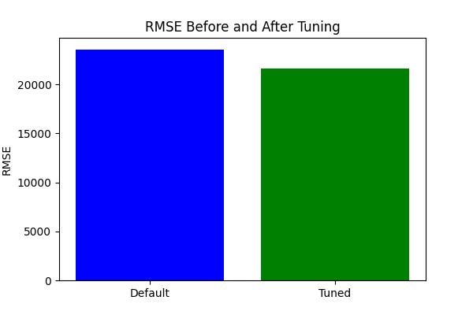
OPTIMISATION
Grid Search CV was used to optimize the Random Forest model.
Hyperparameters: The chosen parameters were: n estimators: 200 (number of trees)
Max depth: 10 (maximum depth of each tree)
Min_samples_split: 10 (minimum samples required to split a node)
Performance: After this tuning process, the model's performance improved:
The Root Mean Squared Error (RMSE) decreased from 23,589 to 21,660.
The R-squared (R2) value increased from 0.92 to 0.93.

Slide 12
CONCLUSION
Essential Discoveries:
Area and Location are the most influential factors.
Linear Regression proved to be a simple and highly effective model.
The tuned Random Forest model delivered strong and stable performance.
Lessons Learned:
Data preprocessing and feature engineering are crucial steps.
Hyperparameter tuning significantly boosts a model's accuracy.
It is vital to carefully handle overfitting and underfitting to ensure reliable results.

Slide 13
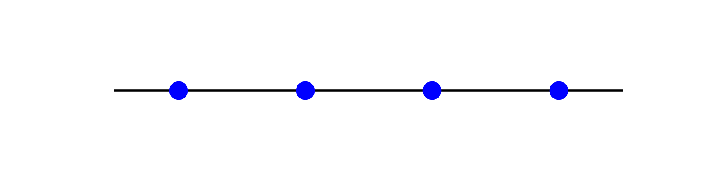
FUTURE OF MACHINE LEARNING
Trends:
• AI-powered healthcare
• Autonomous vehicles
• Natural language understanding
• Edge AI (ML on devices)
Opportunities: Faster, smarter decision-making.
Challenges: Data privacy, ethics, bias in AI.

Slide 14

REFERENCES
Bishop (2006)
https://www.scirp.org/reference/referencespapers?referenceid=3523326
Goodfellow et al. (2016)
https://www.scirp.org/reference/referencespapers?referenceid=2791883
Hastie et al. (2009)
https://scholar.google.com.pk/scholar?q=Hastie+et+al.+(2009&hl=en&as_sdt=0&as_vis=1&oi=scholart
James et al. (2013)
https://scholar.google.com.pk/scholar?q=James+et+al.+(2013)&hl=en&as_sdt=0&as_vis=1&oi=scholart
Breiman (2001
https://scholar.google.com.pk/scholar?q=Breiman+(2001&hl=en&as_sdt=0&as_vis=1&oi=scholart

Slide 15
THANKS
FOR WATCHING

